Slide 1
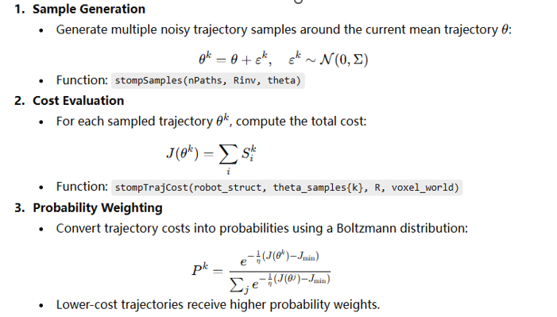
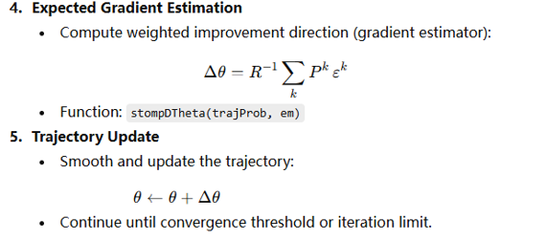
Task 1
Basic task

Slide 2
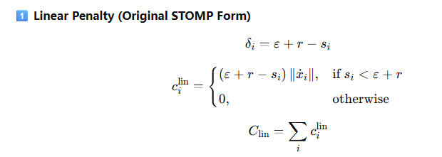
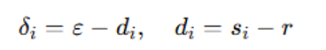
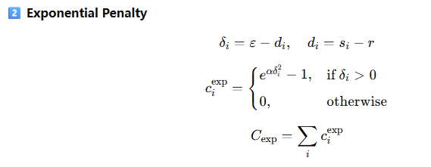
Task 1
Modify the obstacle cost function

Slide 3
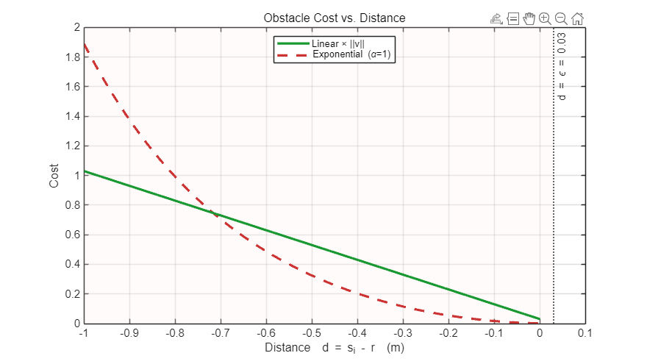
Task 1
Modify the obstacle cost function
The linear penalty increases proportionally to the robot’s proximity and velocity, providing smooth, velocity-scaled soft avoidance.
The exponential penalty rises sharply near obstacles, enforcing strong clearance with large gradients and hard-constraint behavior.

Slide 4



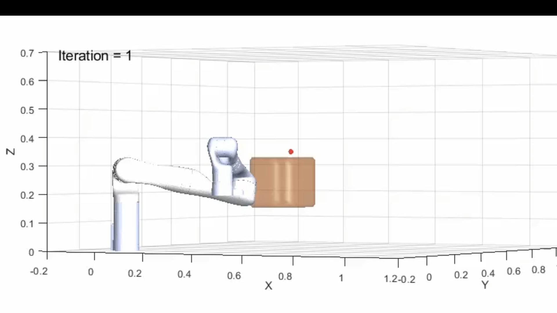
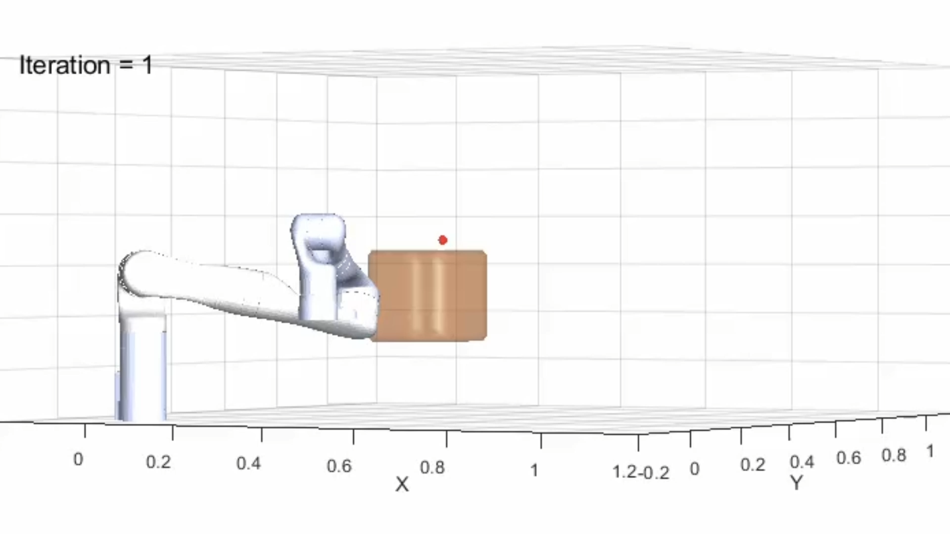
Task 1
Modify the obstacle cost function

Slide 5
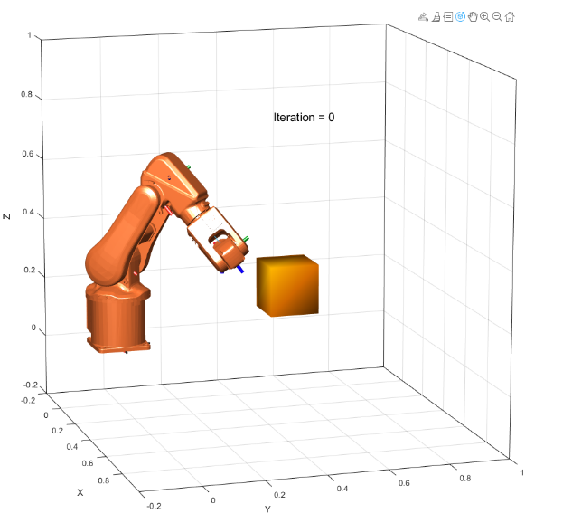
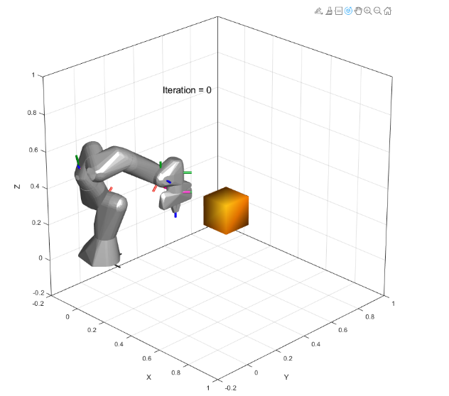
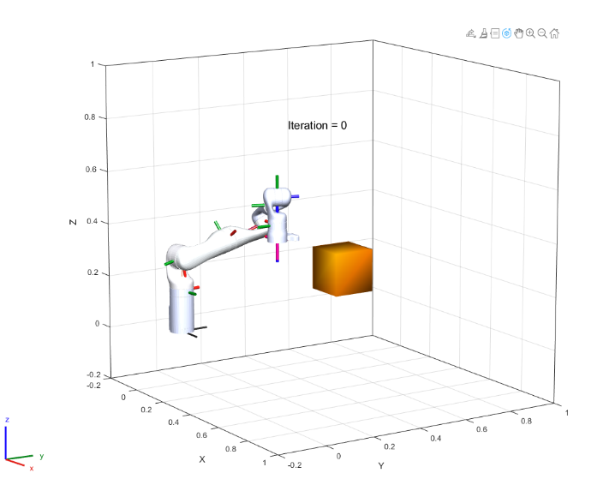
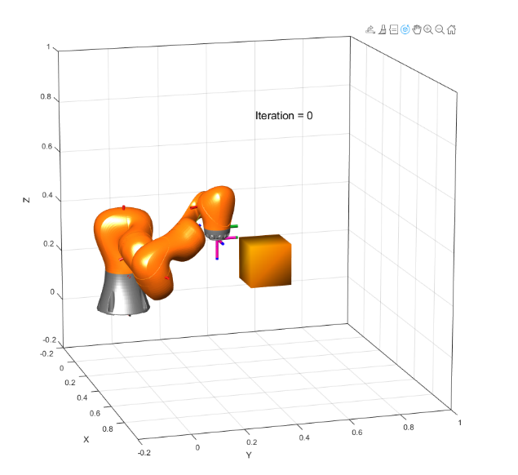
Task2
abbIrb120
frankaEmikaPanda
kinovaGen3
kukaIiwa7

Slide 6
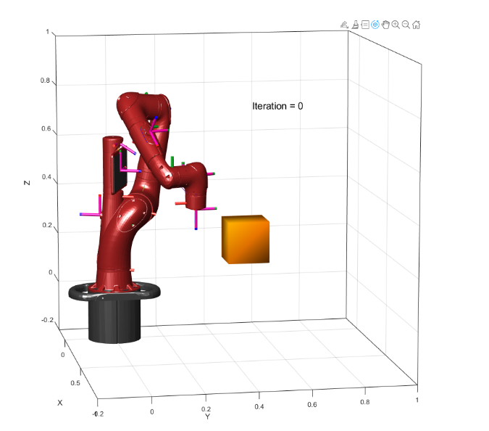
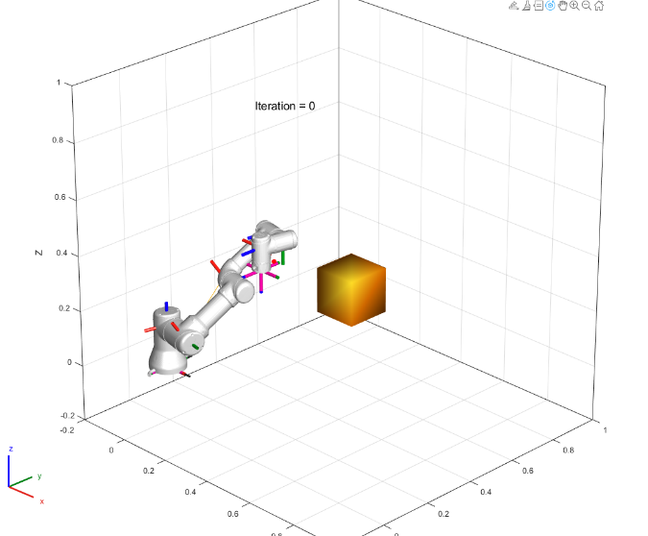
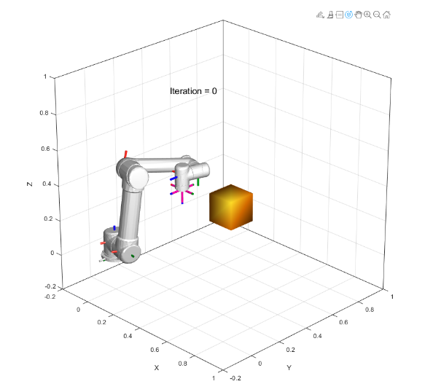
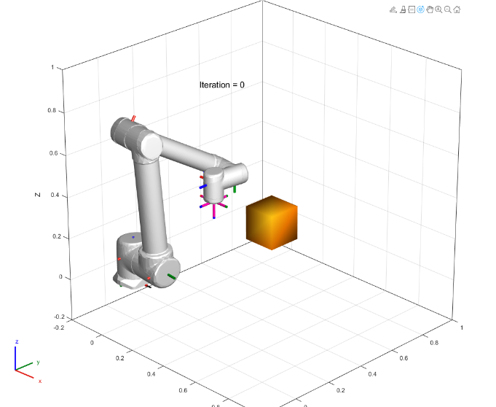
Task2
rethinkSawyer
universalUR3
universalUR5
universalUR10

Slide 7
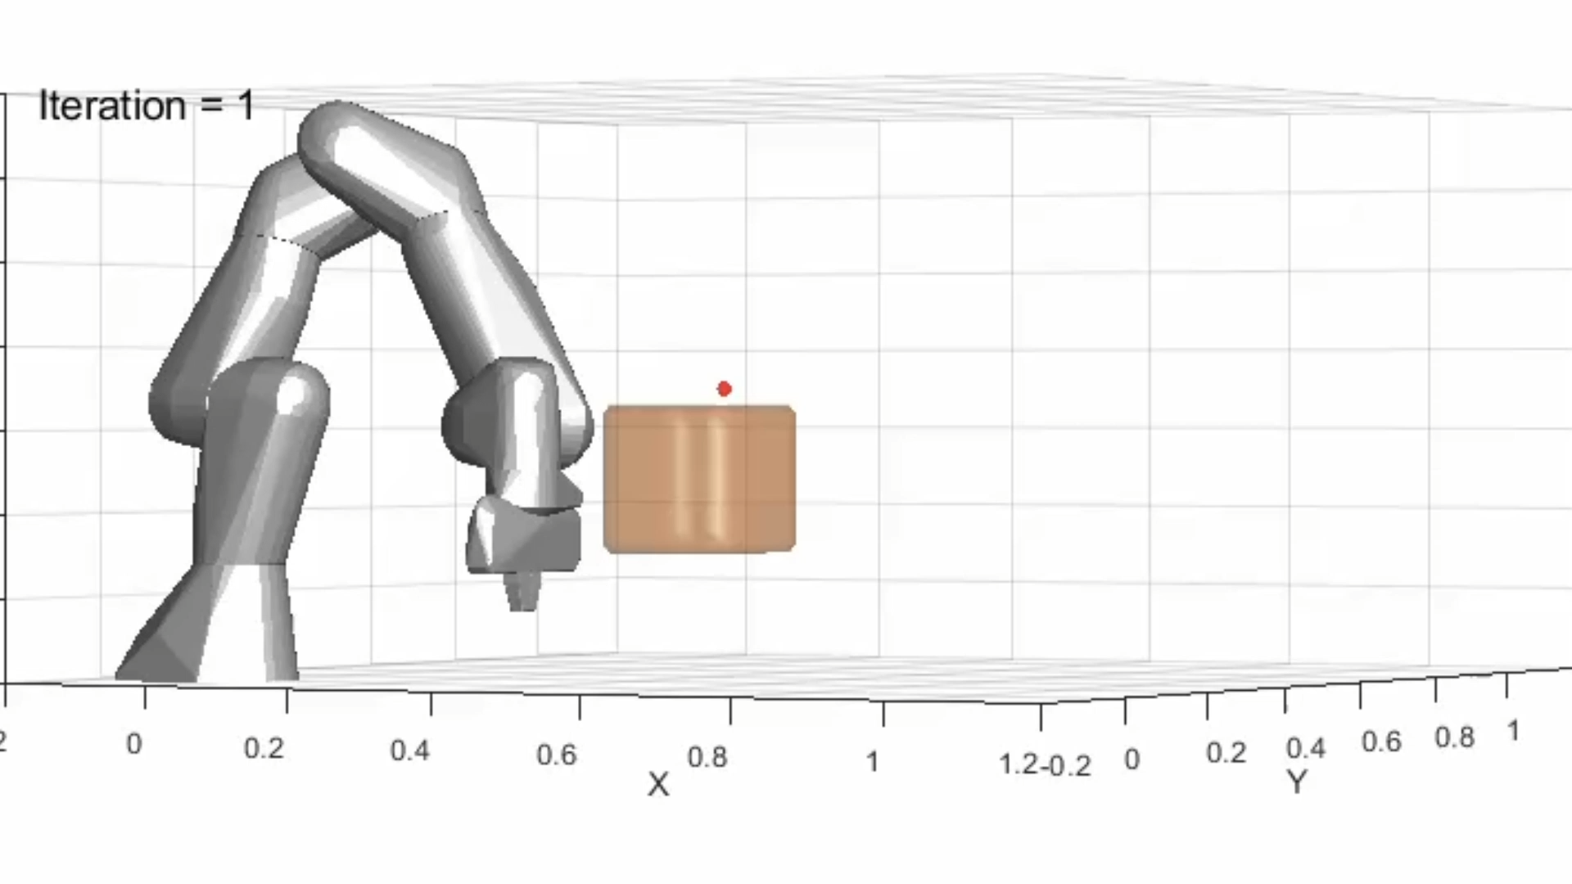
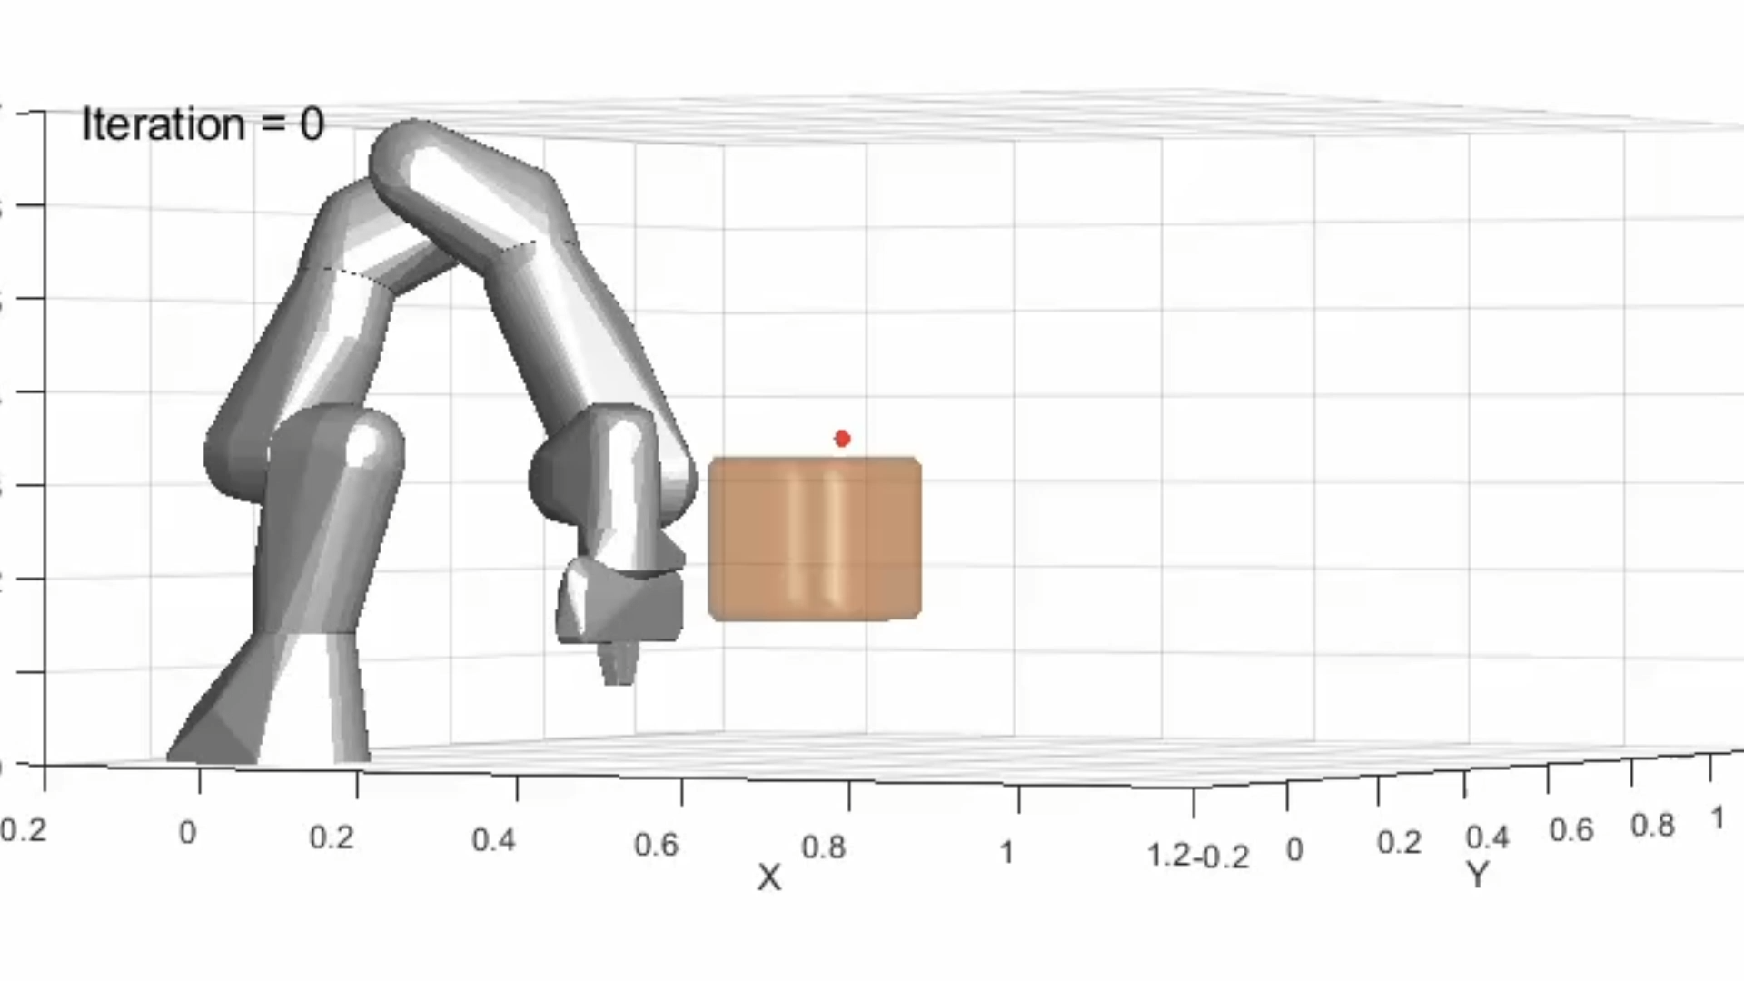
Task2
Franka Emika Panda
The default end-effector of the Franka Emika Panda model is the hand frame (panda_hand), not the fingertip TCP.
Using panda_hand directly for IK or motion planning leads to the issue where the hand reaches the goal but the fingertips penetrate the target surface.

Slide 8
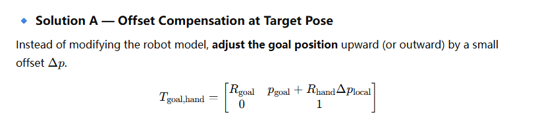
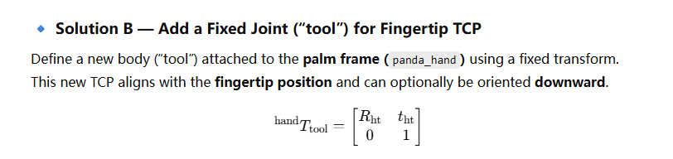
Task2
Franka Emika Panda

Slide 9
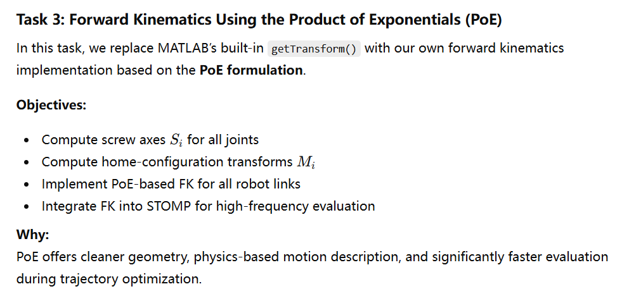
Task3

Slide 10
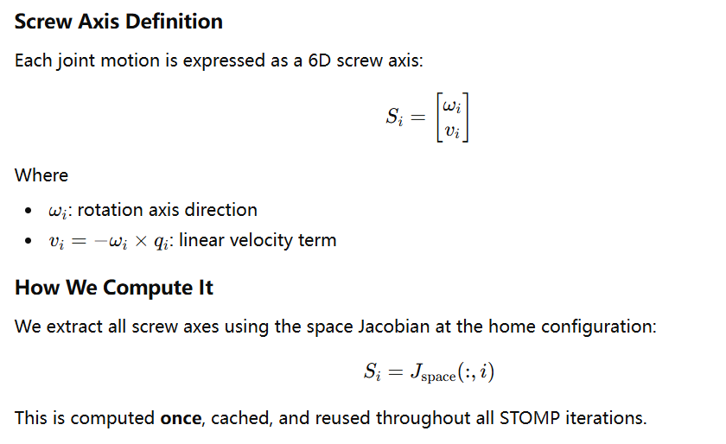
Task3：Screw Axis Extraction

Slide 11
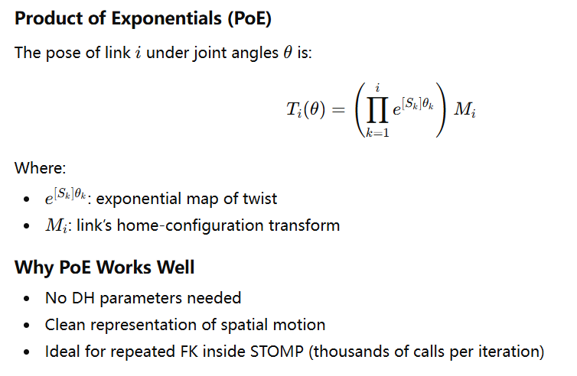
Task3：PoE Forward Kinematics Formula

Slide 12
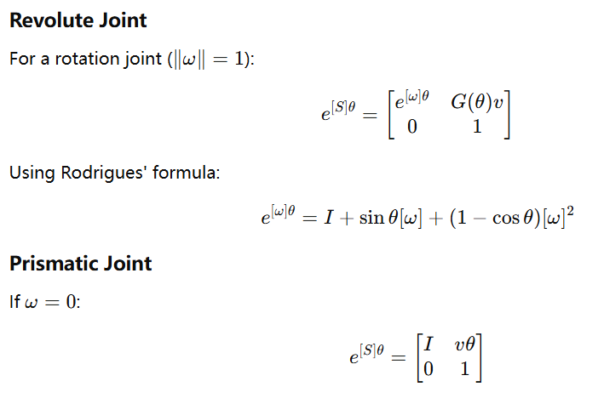
Task3：Exponential Map Implementation

Slide 13
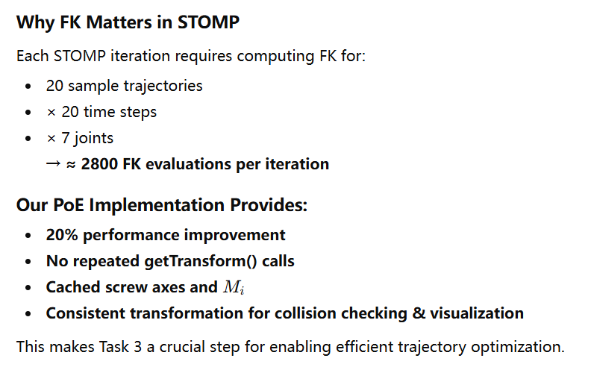
Task3：Integration with STOMP

